Slide 1
Final project presentation
CSCI-SHU 360
Multi-Respiratory Diseases Classifications:
Implementing and Comparing Different Machine Learning Techniques
Ivana Li & Lihan Feng
yl8060 & lf2383

Slide 2
Table of Contents
01
04
02
05
03
06
Introduction & Background
Models
Description of the Problem
Results & Limitations
Data Processing
Conclusion

Slide 3

Introduction & Background
Respiratory Diseases (e.g COVID-19 ) are prevalent
Auscultation needs expertise
Use of decision-support tools such as machine learning techniques to strengthen primary healthcare

Slide 4
Description of the problem
Respiratory disease classification through machine learning models
Whether someone has respiratory diseases
What kind of disease someone may have
Based on the audio data about their respiratory cycles
Compare performance of different models

Slide 5
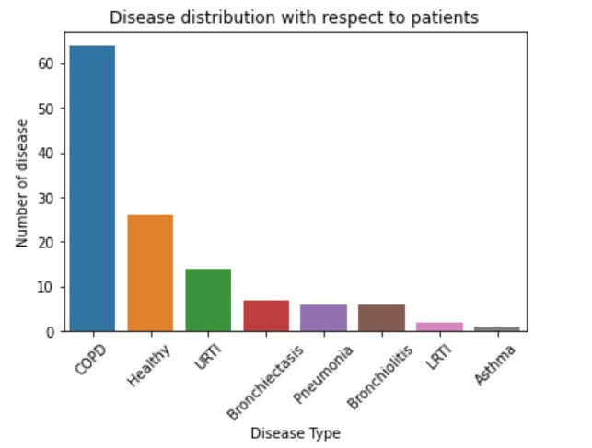
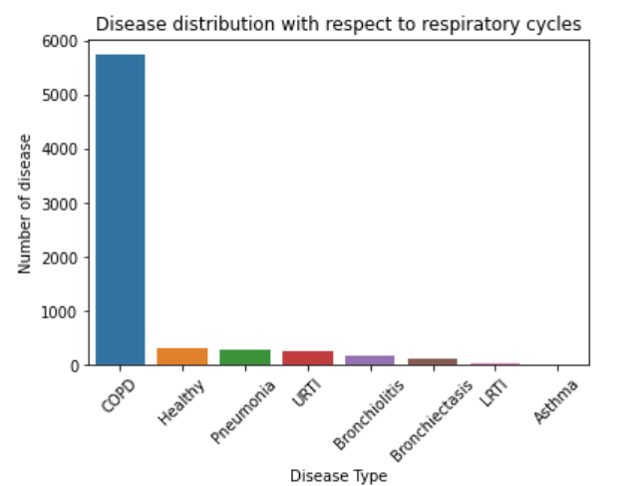
Data Processing
Imbalanced
Raw data

Slide 6
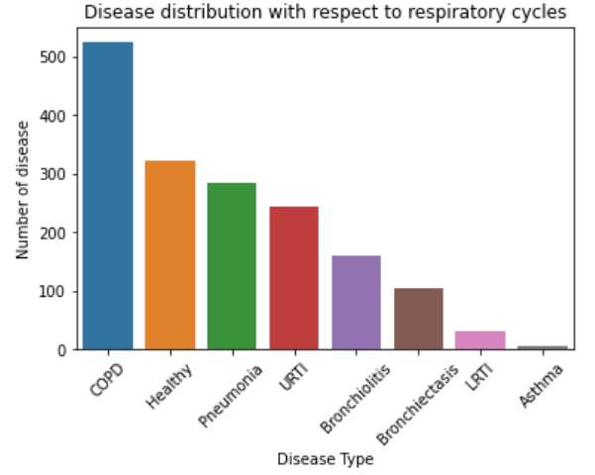
Data Processing
Strategy:
Drop certain cycles with label COPD (based on patients)
Balanced data

Slide 7
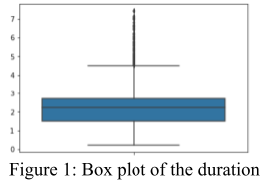
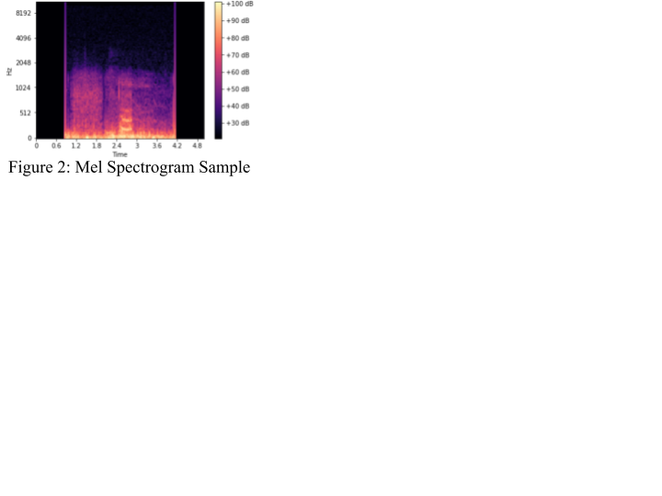
Data Processing
Audio files with respect to patients & labels
1
Generate audio files with respect to cycles & labels
Maintain same input size same length (5s)
2
Convert audio files into Mel Spectrograms & mfcc
Mel Spectrograms:
Visualization of audio data
Mimicking how human ear works
3

Slide 8
Model
Traditional machine learning models
Input: Flattened MFCC
Decision Tree (Tree-based model)
Multiclass SVM (Linear separator)
Deep learning models (Popular models in CV)
Input: RGB Mel-spectrogram images
AlexNet (classical) + MLP
VGG16 (novel) + MLP

Slide 9
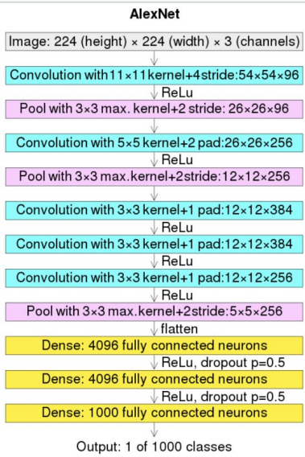
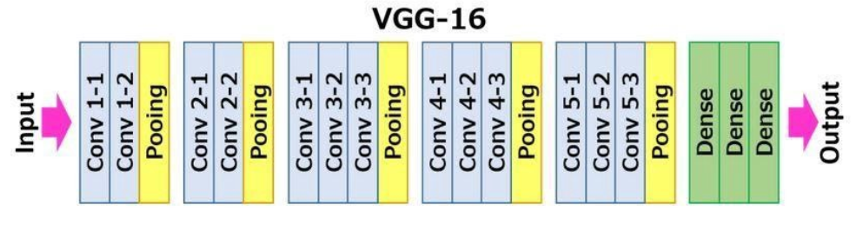
Deep learning models
Add one layer to make output 1 of 8 classes

Slide 10
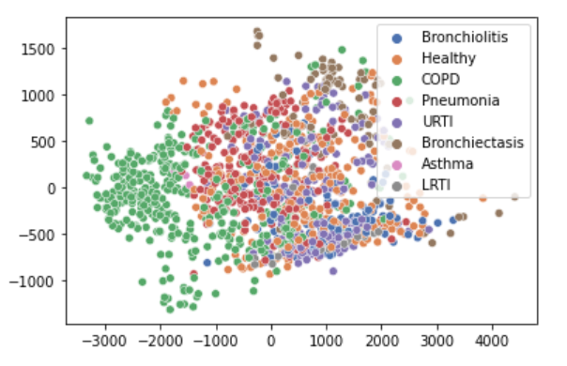
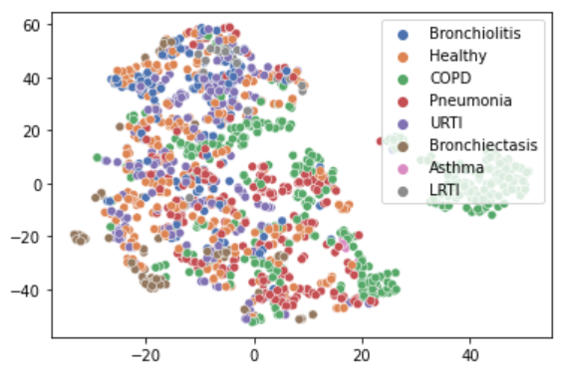
Results
PCA
Metrics: Accuracy
Features might be
More linearly separable
Linear classifier
Works better
Accuracy:
Multi-class SVM: 74.7023%
Decision Tree: 59.5238%
t-SNE

Slide 11
Results
Accuracy:
Pre-trained AlexNet:
64.5833%
Not pre-trained AlexNet:
91.6667%
Pre-trained VGG16:
57.4405%
Not pre-trained VGG16:
95.2381%
Not pre-trained
VGG16 works better:
Improved version of AlexNet
Not pre-trained > pre-trained
Difference between Dataset
Domain Shift

Slide 12
Results
CNN:
Maintain 2D characteristics
Read image data directly
Traditional models:
Destroy 2D characteristics
[flatten 2D arrays of MFCC]
Information loss
In general:
CNN based models work better than traditional machine learning models

Slide 13
Limitations
Noise removal
1
Balanced validation set
2
Future improvement
3

Slide 14
Conclusions
Decision Tree
Traditional ML
Models
SVM
Goal
Input: Flattened MFCC 2D array
Multi-classification
Task
AlexNet + MLP
Deep Learning Models
VGG16 + MLP
Input: RGB Mel-spectrogram image
Transfer Learning
Train-from-scratch
A Review of
the model pipeline

Slide 15
Thank you!

